Slide 1

nature and the economy
Viktoria Kahui (Senior Lecturer)
University of Otago, Department of Economics
27 October 2023
U3A Wanaka
Notes:
Kia ora koutou katoa, ko Viktoria tōku ingoa.
A bit of background on myself
Greek: oikos (house) and nemein (to manage)

Slide 2
Overview
The trouble with GDP
What is natural capital and why is it so important?
How do we value it?
Why is natural capital declining? Who owns it?
Producing thriving nature in the economy

Slide 3
The trouble with GDp
GDP is the market value of all final goods and services produced within a country in a given period of time
Notes:
History of GDP – Kuznet/Keynes; post-war aid dependent on estimates of GDP

Slide 4
“[GDP] does not allow for the health of our children, the quality of their education, or the joy of their play. It does not include the beauty of our poetry or the strength of our marriages, the intelligence of our public debate or the integrity of our public officials. It measures neither our courage, nor our wisdom, nor our devotion to our country. It measures everything, in short, except that which makes life worthwhile, and it can tell us everything about America, except why we are proud that we are Americans.”
US Senator Robert Kennedy, running for president in 1968

Slide 5

Notes:
Addison Rae (left), Charlie Demilio (right)

Slide 6


Slide 7
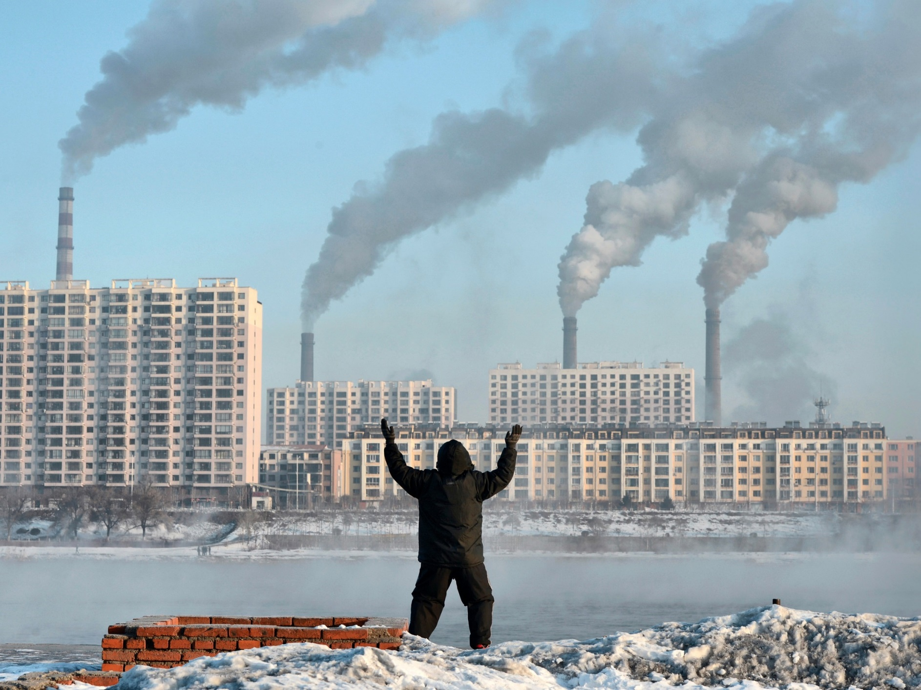

Slide 8
GDP does Not measure:
The value of leisure time, the benefit from free digital services
Unpaid work (care for children, voluntary work)
Income inequality
Environmental damage / biodiversity loss

Slide 9
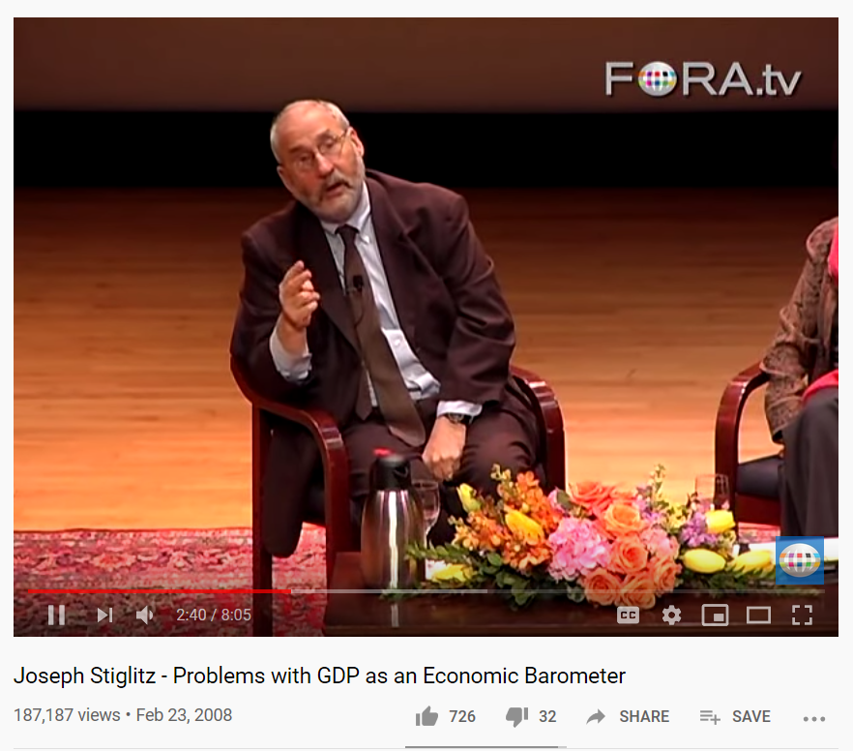
Joseph Stiglitz - Problems with GDP as an Economic Barometer
https://www.youtube.com/watch?v=QUaJMNtW6GA
Notes:
Joseph Stiglitz won the Noble Prize in Economics in 2001 for his work on asymmetric information (risk aversion)

Slide 10
Wellbeing economics
The policy language in New Zealand has shifted from a focus on higher growth towards a focus on greater wellbeing – Living Standard Framework
“New Zealand needs to measure success in new ways. … The economic strategy will focus on how we improve the wellbeing and living standards of all New Zealanders.”
Speech from the Throne (8 November, 2017)
Notes:
In 2019, NZ had a ‘world first’ wellbeing budget focusing on mental health services, child poverty and domestic violence

Slide 11
The shift from growth to wellbeing is a global phenomenon
“The time is ripe for our measurement system to shift emphasis from measuring economic production to measuring people’s well-being.”
2009 Report by Stiglitz, Sen and Fitoussi
Notes:
Shift to measuring wellbeing is taking place around the world, including in the UK since 2010, OECD wellbeing framework, quality of life framework in EU, global development indicators by World Bank and Sustainable Development Agenda by UN.

Slide 12
What is natural capital and why is it so important? https://www.youtube.com/watch?v=y_iwCWD8cvE

Slide 13
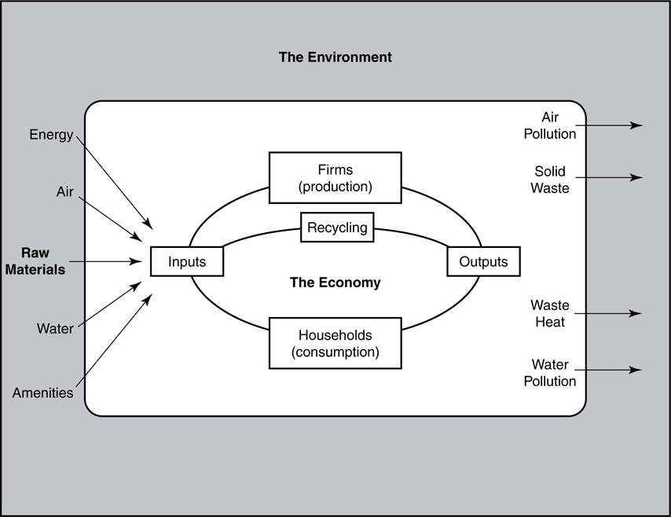
Notes:
Self-sustaining macro economic circular flow of production and consumption

Slide 14
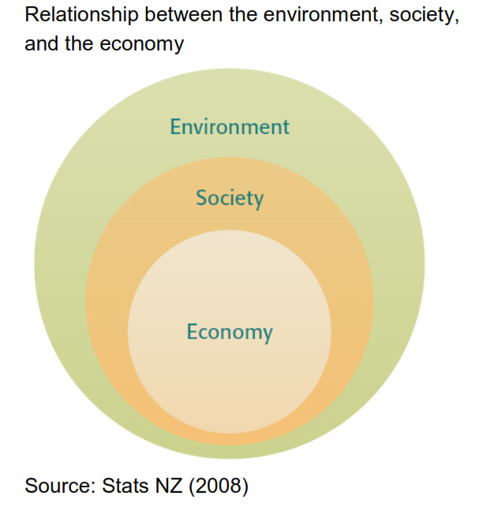
Notes:
Ecological economics

Slide 15
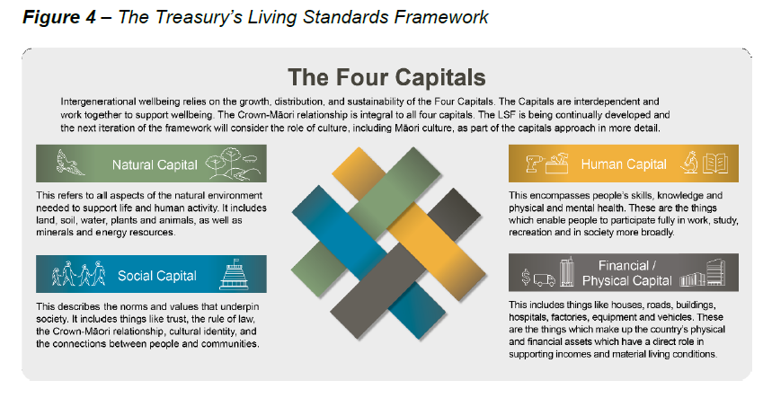

Slide 16
Definition of natural capital
“Natural capital refers to all aspects of the natural environment. It includes individual assets such as minerals, energy resources, land, soil, water, trees, plants and wildlife. And, also includes broader ecosystems and their services – ie, the joint functioning of, or interactions among, different environmental assets, as seen in forests, soil, aquatic environments and the atmosphere.”
The Treasury, 2018

Slide 17
What are ecosystem services?
Beautiful landscape around Wānaka
Clean drinking water from the lakes and reservoirs
Fertile soil and climate that produces Pinot Noir
Timber harvested for heating
…..

Slide 18
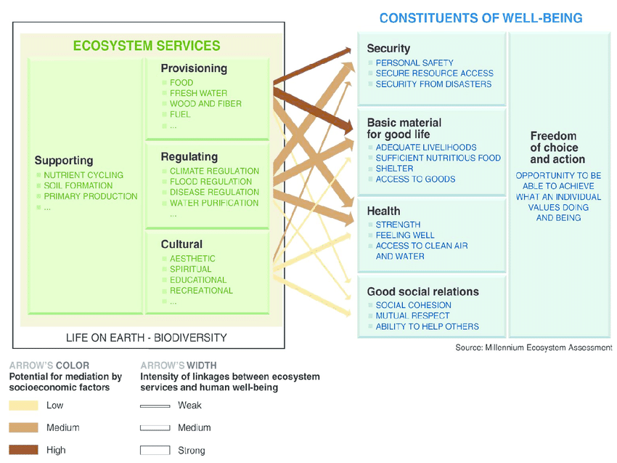
Millennium Ecosystem Assessment

Slide 19
Why is natural capital so important?
Weak sustainability: what matter is non-declining total wealth
Strong sustainability: what matters is non-declining natural wealth
The example of Nauru (small Pacific island northeast of Australia): trading income from phosphate mining for ecosystem services

Slide 20
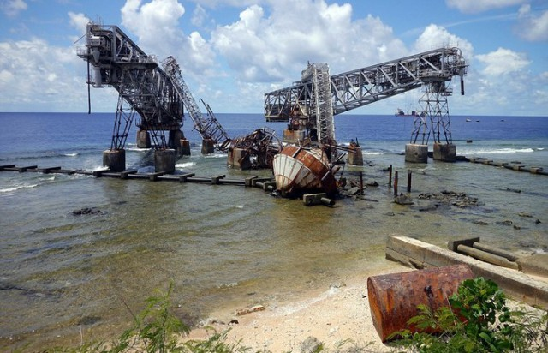

Slide 21
The case for strong sustainability
Lack of sufficient substitutability
Uncertainty & irreversibility
Intra-generational equity: the poor are often more adversely affected by poor environmental quality than the rich (Environmental Justice)
Inter-generational equity: what do we ‘owe’ future generations?
Notes:
Mention research project on studying water pollution in India

Slide 22
How do we value natural capital?

Slide 23
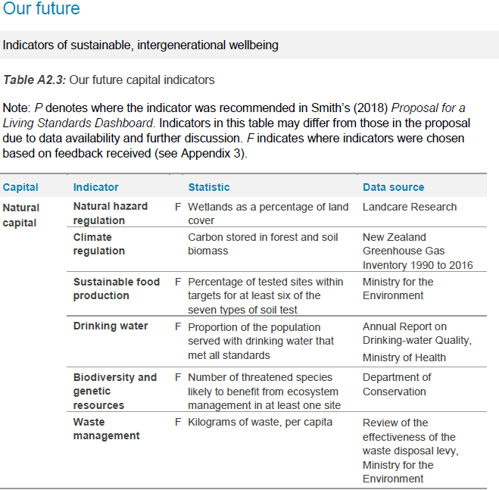
Indicators for Natural Capital in New Zealand’s Living Standard framework?

Slide 24
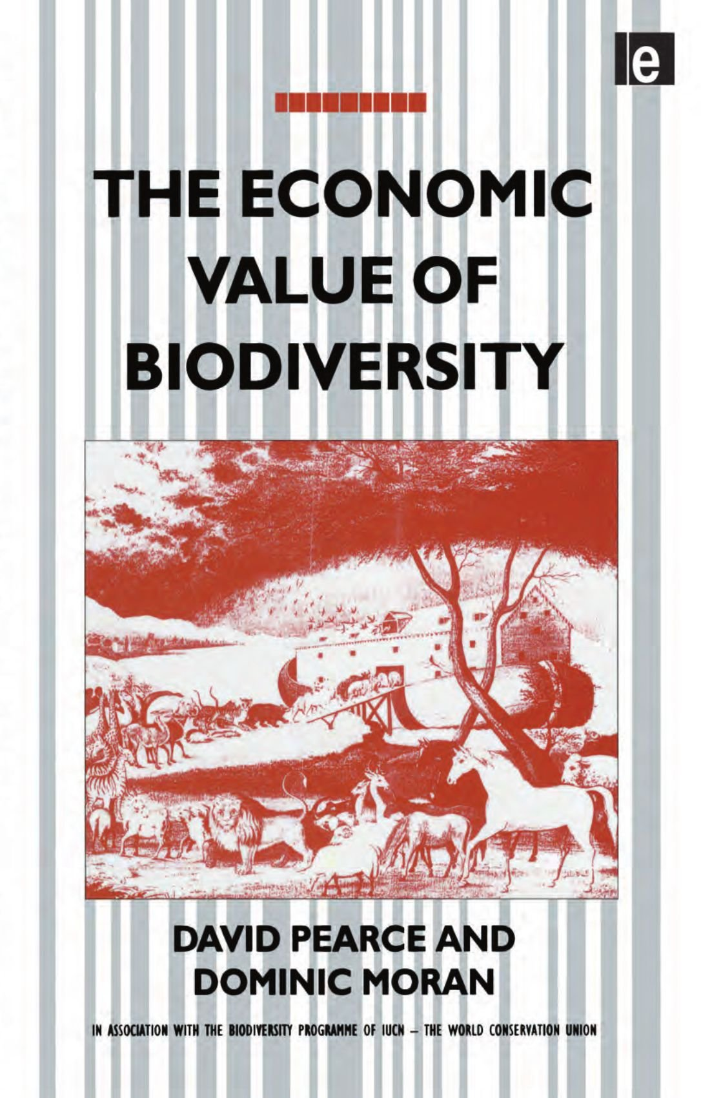
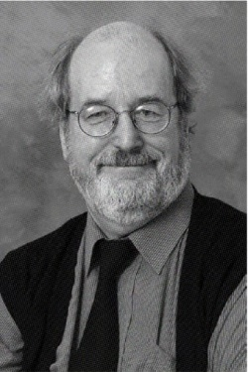
Prof. David Pearce (economist) argued that the environment is "under-priced“ and developed the TEV framework

Slide 25
Total Economic value (TEV)
TEV = Use value + Non-use value + Option value

Slide 26
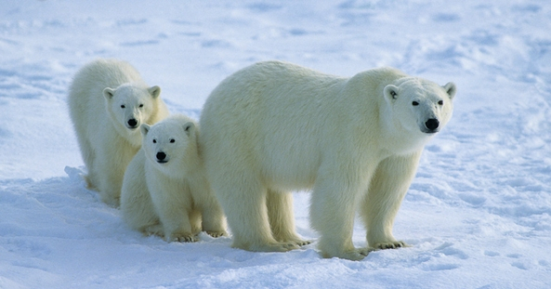
What’s the value of a polar bear?

Slide 27
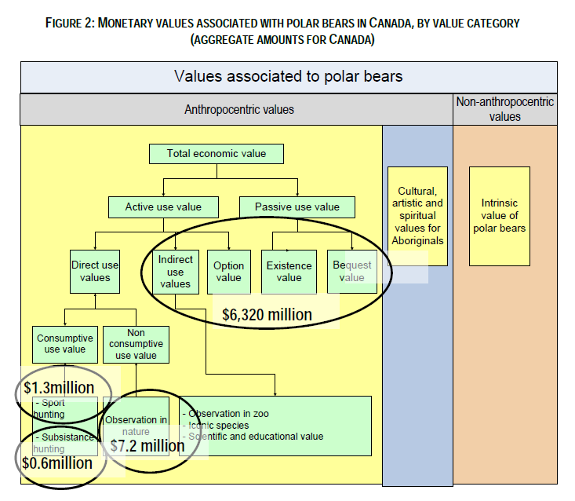

Slide 28
Methods for valuation
Many different methods, e.g.
Contingent valuation: Surveys asking people how much they are willing to pay to preserve the Polar bear
Travel cost method: Asking people how many trips they take to the Arctic to see Polar bears and how far they travel
Notes:
All of the methods involve statistical analysis; mention famous Exxon Valdez study for contingent valuation

Slide 29
Recent study estimates the value of the beaches at Mount Maunganui:
In person surveys of current users over course of two weeks in Jan/Feb 2021
434 beach goers were approached at random (over 18 years of age)
193 usuable responses (44.5% response rate)
Questions included
  What type of transportation was used
  Where from did respondents travel
  Where did respondents stay (accommodation)
  Travel party size
  Socio-demographic information (education level, gender, employment status, annual household income, age)
Notes:
Mention project with student over summer: The recreational value of the Brighton Beach in Dunedin – An application of the travel cost study

Slide 30
Economic value of Mount Manganui beaches:
NZD 77.78 million
Another example: in 1997, researchers estimated that the world’s ecosystem services are worth US$16-54 trillion per year
What do we do with these numbers?
Notes:
Could use these numbers in cost-benefit analysis, but many problems with that

Slide 31
Why is natural capital declining? Who owns it?

Slide 32
“1 Million Species at Risk of Extinction”
Intergovernmental Science-Policy Platform on Biodiversity and Ecosystem Services (IPBES).
changing use of sea and land
direct exploitation of organisms
climate change
pollution
invasive non-native species
Notes:
IPBES compiled by 145 experts from 50 countries

Slide 33
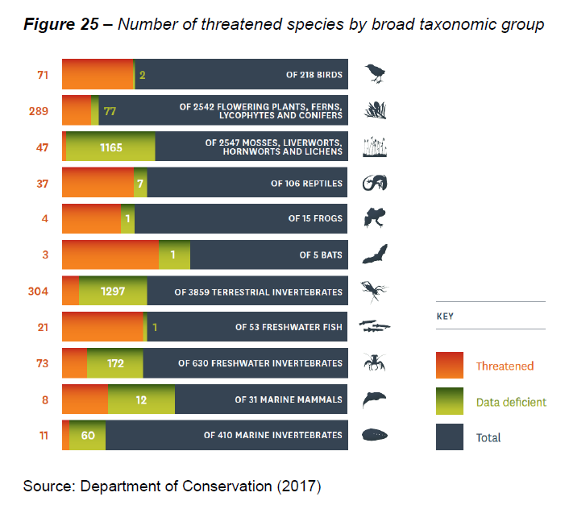
Notes:
Other indicators: energy consumption per capita; loss of wetland area, drinking water quality etc.

Slide 34
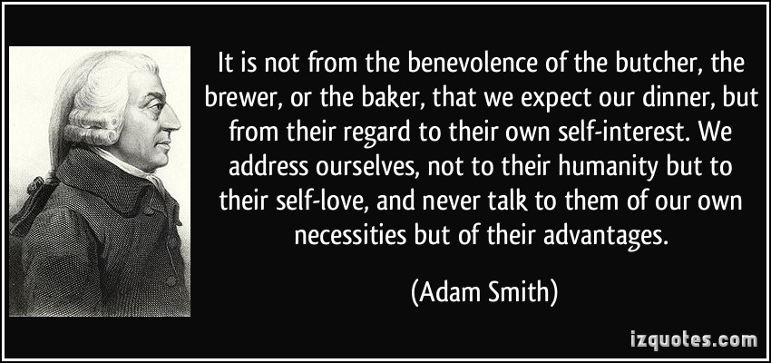
Adam smith’s invisible hand

Slide 35
But Markets do fail….
(Taken from Tax Working Group, 2019; p. 39)

Slide 36
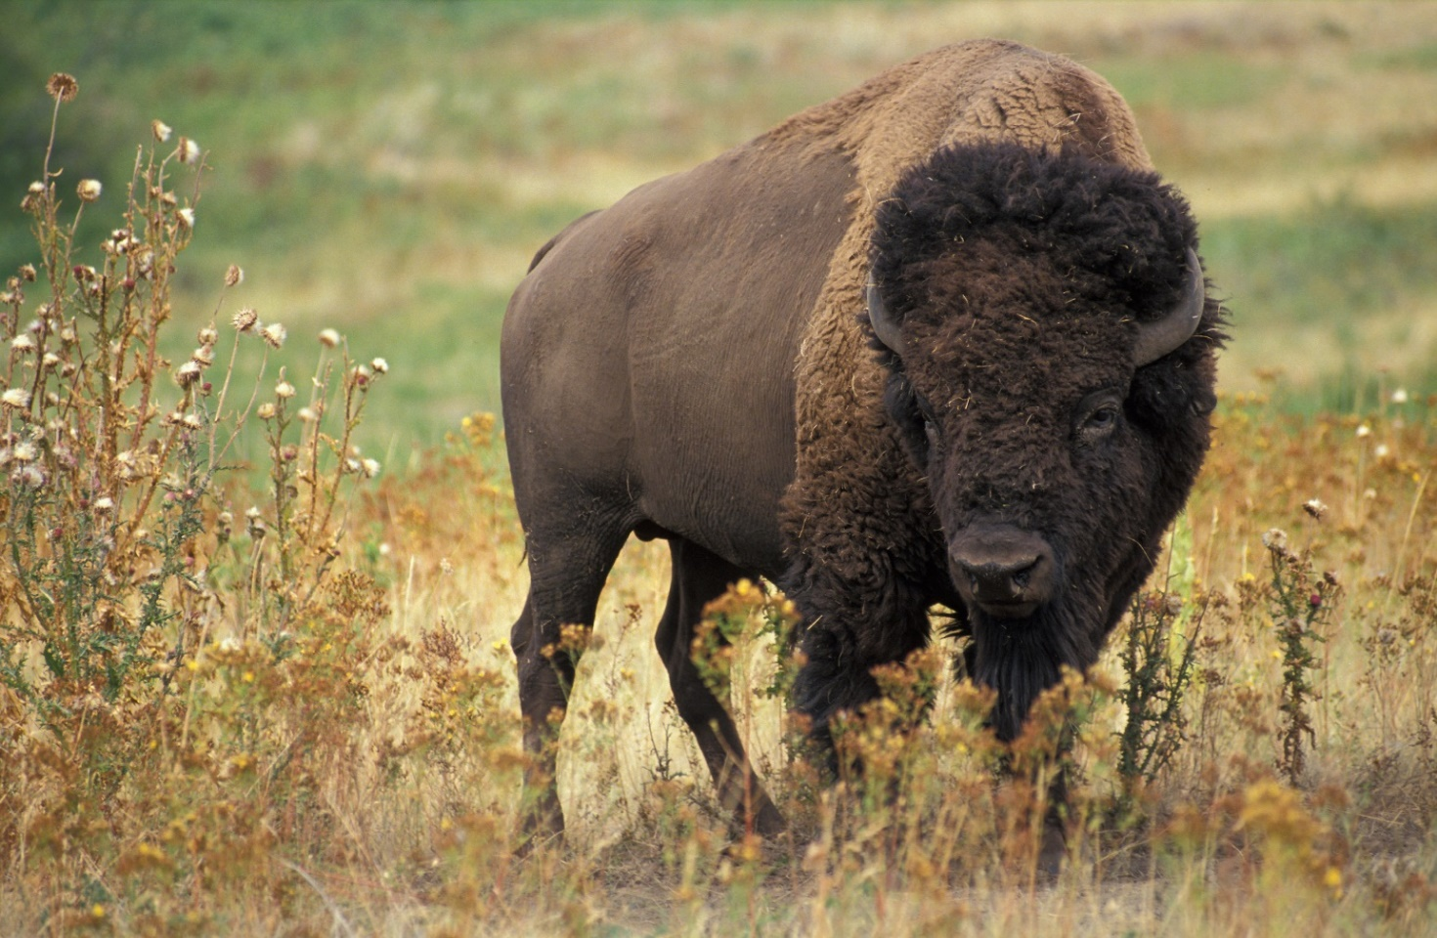
Tragedy of the commons
Symbolises the degradation of environment whenever individuals use a scarce resource that is not owned
Notes:
Garrett Hardin (1968)
Common pool resources (rival/non-excludable) are overexploited: traditionally fish, timber, etc.

Slide 37
John Key, 2012: “No one owns the water”
"Māori, I think, have an interest and relationship with water, but the Government’s view is that they don’t own water in the way that anyone in New Zealand owns water, nor do we believe anyone owns the air or the sea. In fact the position of no one owning the water has been established in common law quite some time ago...”
Parliamentary Commissioner for the Environment 2013: highlights the widespread decline in water quality due to dairying
Notes:
Jan Wright: shift from sheep and beef farming to dairying has lead to increased leaching of nitrogen and phosphorus into waterways which in turn causes excessive growth of weeds and algae, choking waterways.

Slide 38
Who owns natural capital?
No Ownership
Public Ownership (Regulations and Taxes)
Private Ownership (e.g. land, carbon credits, fish quota)
Common Ownership (e.g. community led restoration projects)
Self-ownership (e.g. Whanganui River)
Notes:
Environmental taxes (public ownership) used in some countries but not NZ

Slide 39
Producing Thriving nature in the economy

Slide 40
Managing nature is foremost about managing people
No ownership leads to the tragedy of the commons
Regulations need to be flexible to allow for cost-effective responses
Innovative sources of finance for nature-positive outcomes
Beware of perverse incentives (unintended consequences)
Support community-led restoration projects
Support guardianship model of nature
Notes:
Costs matter! Production costs (opp cost plus labour/inputs), transaction costs (ex ante and ex post) and externality costs (loss of biodiversity and wellbeing)

Slide 41
2. Regulations need to be flexible
e.g. National Policy Statement for Freshwater Management 2020
For farmers this meant
Mandatory freshwater farm plans in addition to existing reporting
Mandatory fencing and destocking regardless of rainfall or soil type
Restrictions on development of feed lots and winter forage crops…

Slide 42
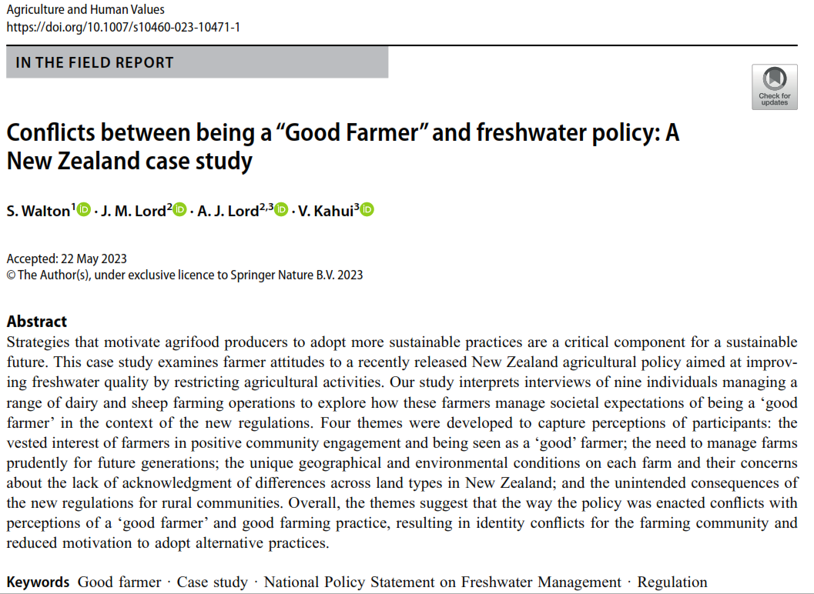

Slide 43
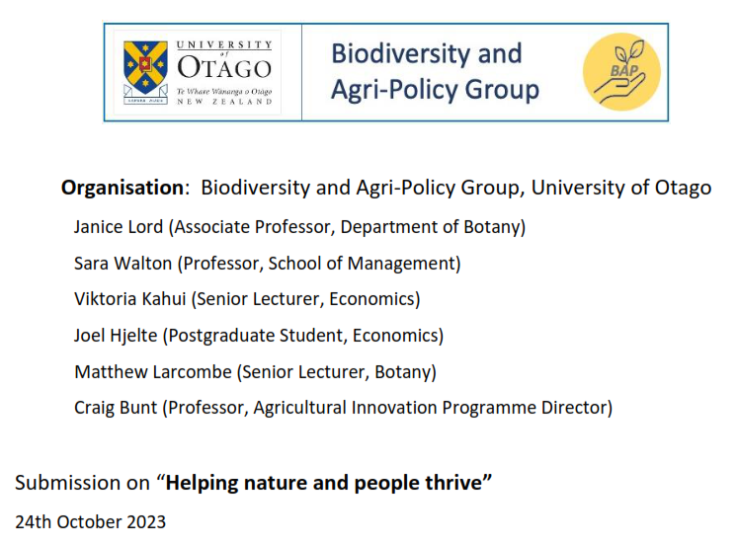
3. Innovative sources of finance

Slide 44
4. Beware of perverse incentives
e.g. Carbon credits in New Zealand have incentivised monoculture (pine plantations)

Slide 45
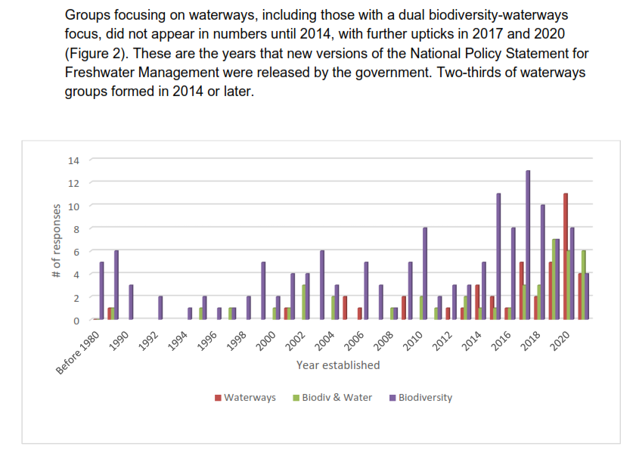
5. Support community-led restoration
Notes:
Cawthrown institute

Slide 46
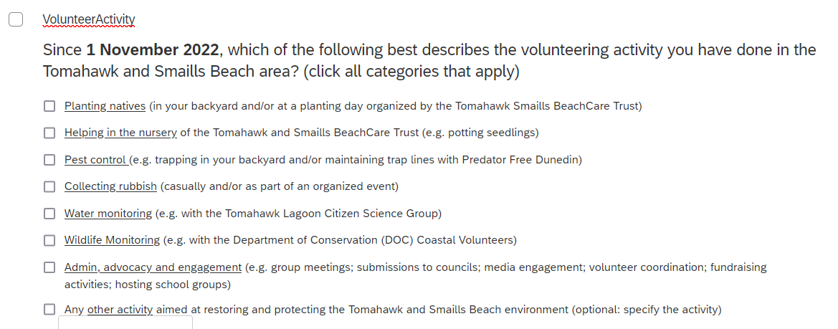
Volunteer survey

Slide 47
6. Support guardianship model of nature
National Policy Statement for Freshwater Management 2020
Te Mana o te Wai prioritises, in the following order
  1. The health and well-being of water bodies and freshwater ecosystems
  2. The health needs of people
  3. The ability of people and communities to provide for their social, economic, and cultural well-being, now and in the future

Slide 48
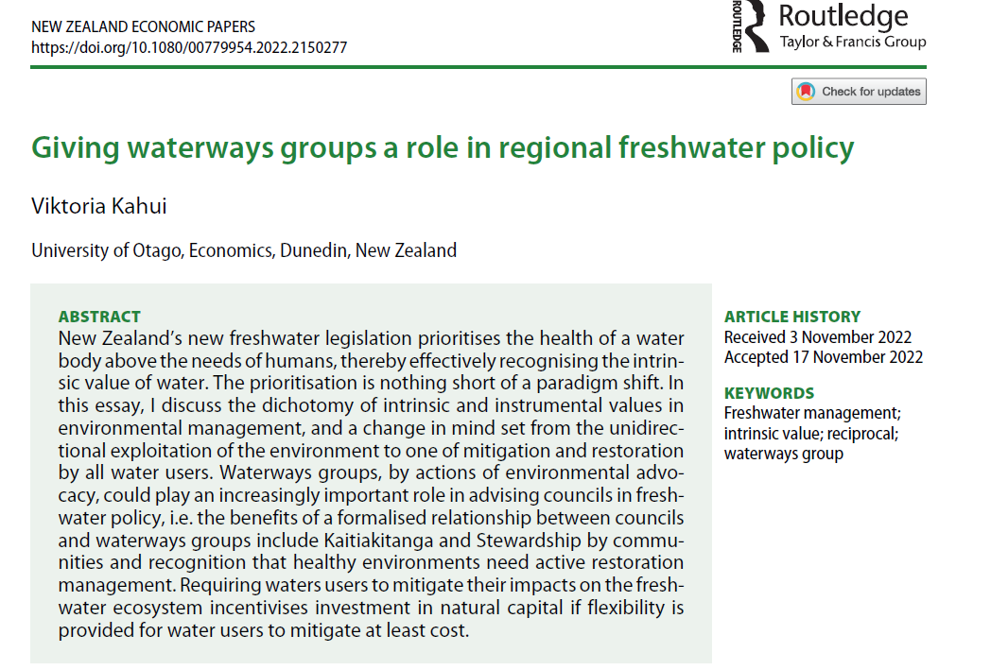

Slide 49
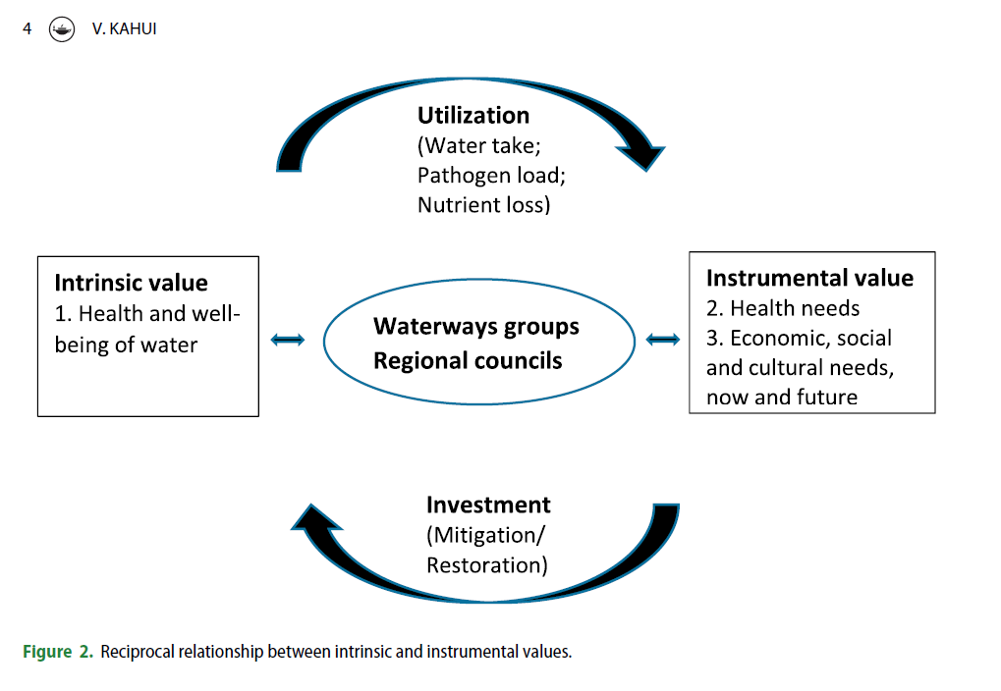

Slide 50
The river that owns itself
In 2017, Whanganui River was recognized as
“an indivisible and living whole comprising the Whanganui River from the mountains to the sea, incorporating all its physical and metaphysical elements” (Te Awa Tupua Act 2017)
The ‘human face’ (guardians):
representative by the Whanganui Iwi, Crown and advisory group

Slide 51
